Slide 1




Development of master curricula for natural disasters risk management in Western Balkan countries
Education and research activities at OE, Hungary
Ágota DRÉGELYI-KISS, PhD, vice-dean for research
Bánki Donát Faculty of Mechanical and Safety Engineering,
Óbuda University, Hungary
Kick-off meeting/ 15 December 2016
Project number: 573806-EPP-1-2016-1-RS-EPPKA2-CBHE-JP
"This project has been funded with support from the European Commission. This publication reflects the views only of the author, and the Commission cannot be held responsible for any use which may be made of the information contained therein"

Slide 2
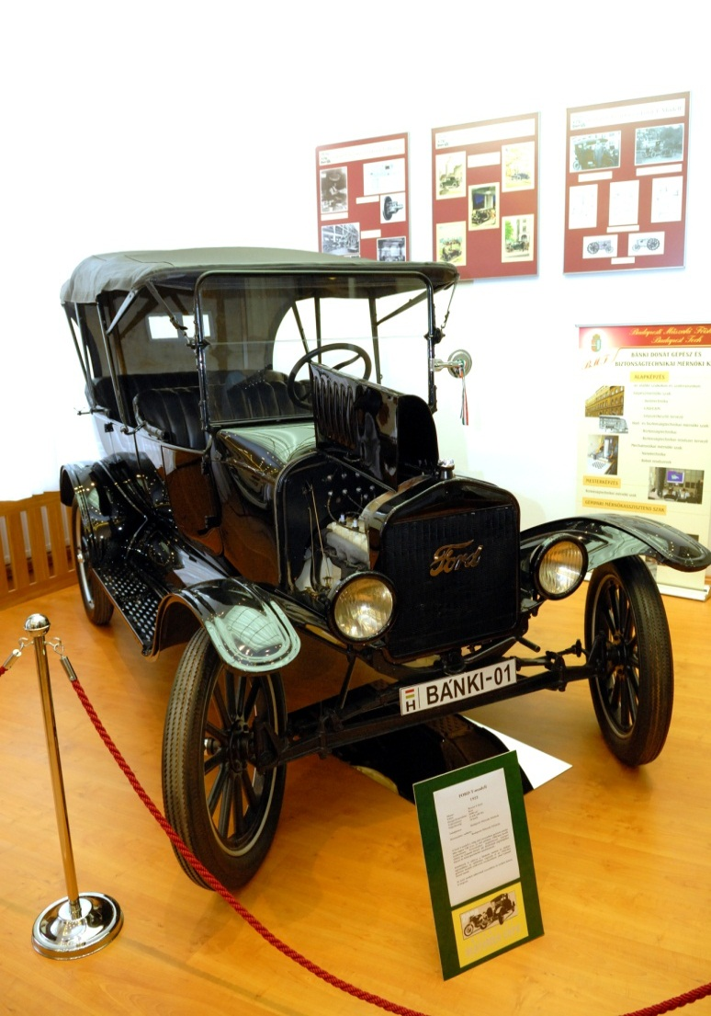
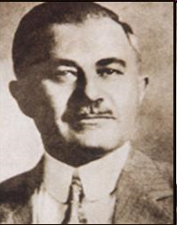
Famous Hungarian inventors
Development of master curricula for natural disasters risk management in Western Balkan countries
Chief Designer of Ford Model T
the most famous alumnus of Óbuda University
Mr. József GALAMB
Óbuda University, Budapest, Hungary (OE)

Slide 3
Hungarian Higher Educational System
Development of master curricula for natural disasters risk management in Western Balkan countries
Pre-Bologna system (up to 2006):
  university-level degree,
  college-level degree.
Bologna system fully adopted with the three consecutive training cycles from 2006:
  Bachelor, BSc,
  Master, MSc,
  Doctorate, PhD.
Óbuda University, Budapest, Hungary (OE)

Slide 4
Brief History
Development of master curricula for natural disasters risk management in Western Balkan countries
Intellectual heir of former Óbuda University, was established on August 1, 1410 (mentioned in a Papal Bull) as the very first university in Budapest by King Sigismund.
1879: re-establishment as Royal Hungarian State Higher Vocational School, Bánki Donát Polytechnic.
End of ‘60th: Bánki Donát Polytechnic, Kandó Kálmán Polytechnic , and Technical College of Light Industry unified in Budapest Tech - Polytechnic Institution
2010: The new name of ÓBUDA University was given by the Hungarian Parliament as the legal successor to the Budapest Tech
Óbuda University, Budapest, Hungary (OE)

Slide 5
Óbuda University
Pro Scientia et Futuro
Development of master curricula for natural disasters risk management in Western Balkan countries
A leading institute of higher education in engineering, IT and economics in Hungary with international outreach.
Offering high-quality and competitive undergraduate, graduate and doctoral programs, vocational training and professional extension courses.
Internationally acknowledged research and development opportunities, facilities.
Professional and recognized scholars, helpful staff, talented students.
Young university with long history.
Óbuda University, Budapest, Hungary (OE)

Slide 6
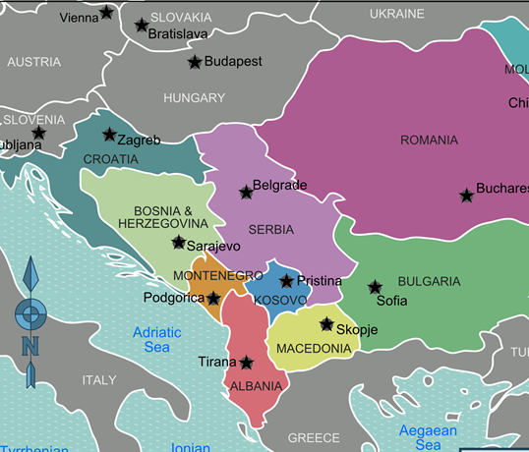

Óbuda University Today
Development of master curricula for natural disasters risk management in Western Balkan countries
Five faculties
Two centers
Three campuses
ca. 12,000 enrolled students
ca. 900 employees
ca. 400 academic staff
Óbuda University, Budapest, Hungary (OE)

Slide 7
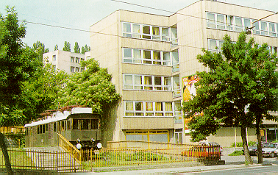
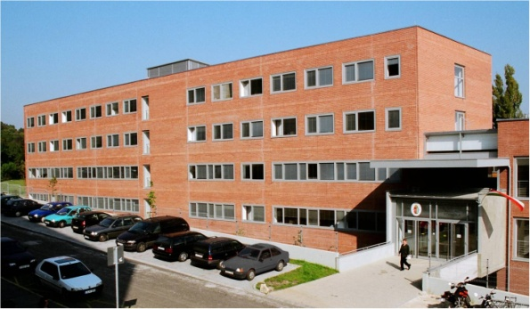
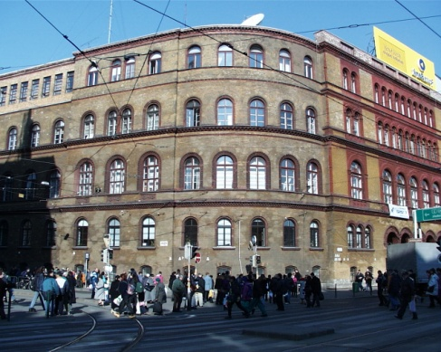
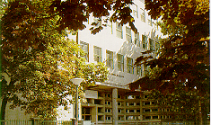
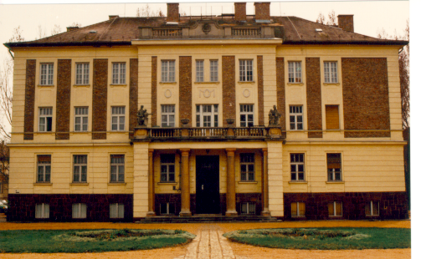
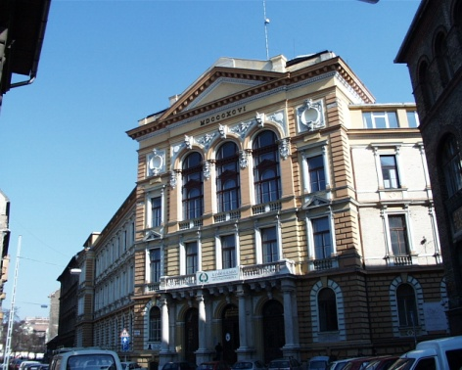
Development of master curricula for natural disasters risk management in Western Balkan countries
Campuses and Locations
Budapest
Óbuda
Budapest
Józsefváros
Székesfehérvár
Óbuda University, Budapest, Hungary (OE)

Slide 8
Óbuda University
Development of master curricula for natural disasters risk management in Western Balkan countries
Faculties
Bánki Donát Fac. Of Mechanical and Safety Engineering
Kandó Kálmán Fac. Of Electrical Engineering
Doctoral Schools
Safety and Security Sciences
Material Sciences and Technologies
Keleti Károly Fac. Of Economics
Neumann János Fac. Of Informatics
Rejtő Sándor Fac. Of Light Industry and Environmental Protection Engineering
Applied Informatics and Applied Mathematics
Óbuda University, Budapest, Hungary (OE)

Slide 9
Educational programs of the Faculty
Development of master curricula for natural disasters risk management in Western Balkan countries
Bologna system of education
BSc: full-time, correspondence, and part-time course;
7 semesters
MSc: full-time, and correspondence course;
4 semesters
PhD: full-time, and correspondence course;
6 semesters
Mechanical Engineer
Mechatronics
Safety Engineering
Safety and Security Engineering
Óbuda University, Budapest, Hungary (OE)

Slide 10
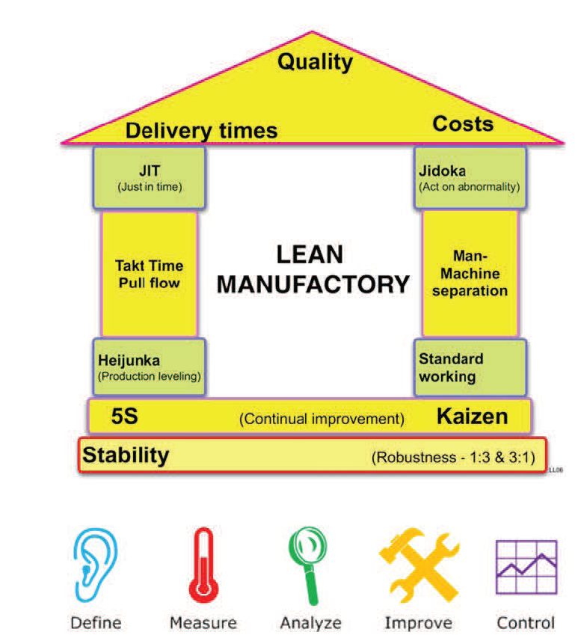
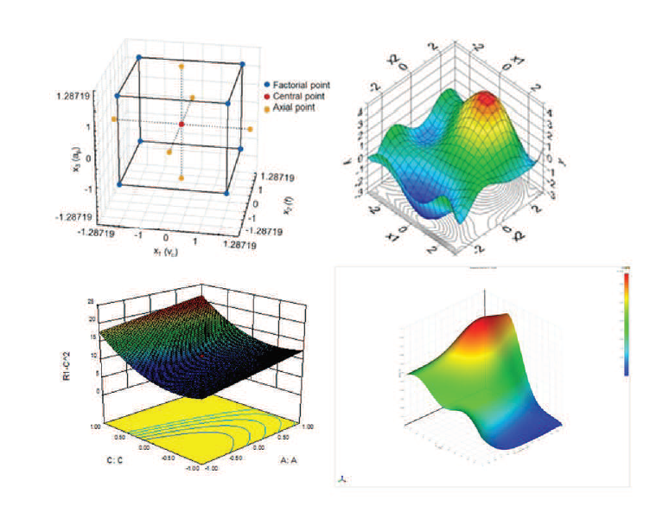
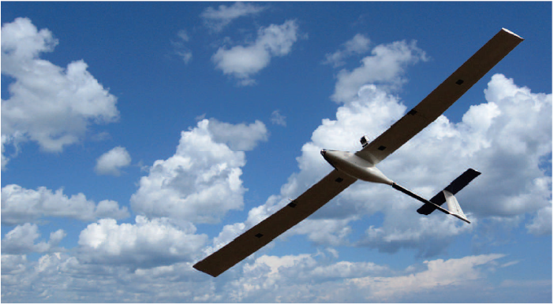
Selected Research activities of the Faculty
Development of master curricula for natural disasters risk management in Western Balkan countries
Quality in automotive industry and risk analysis
Data evaluation with multivariate statistics
Unmanned Aerial Vehicle (UAV) systems
Óbuda University, Budapest, Hungary (OE)

Slide 11
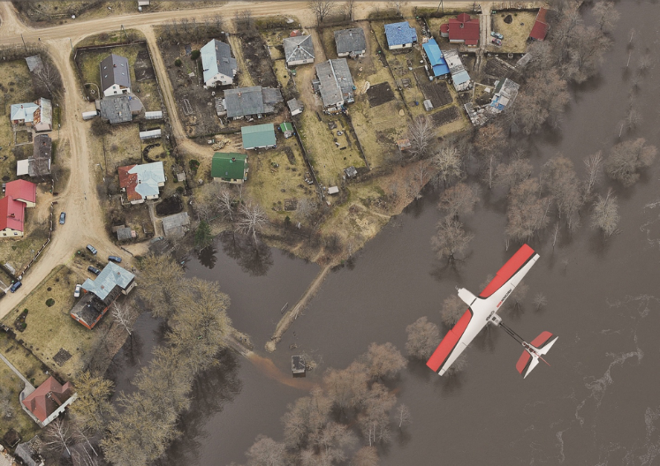
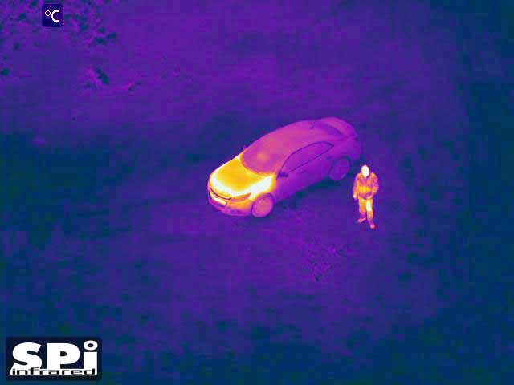
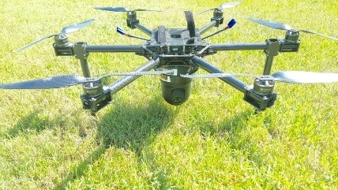
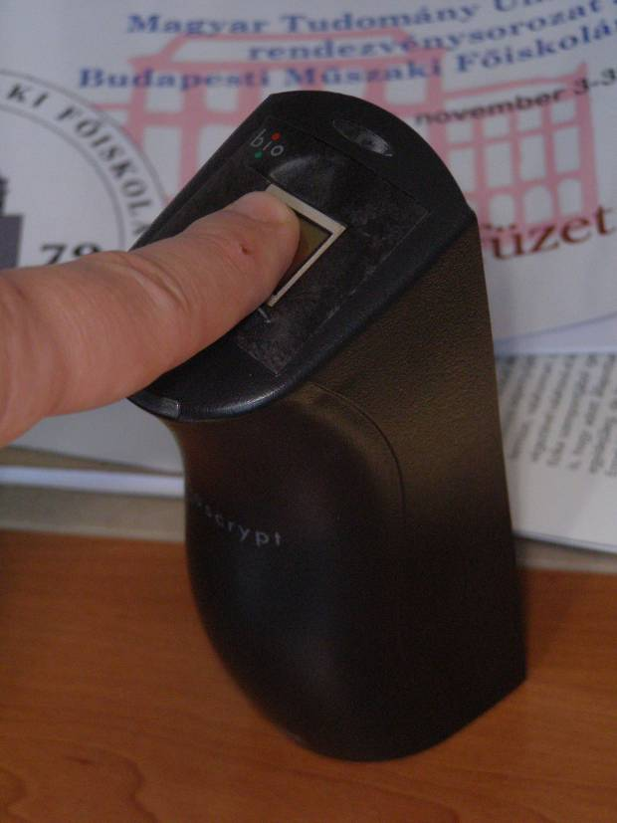
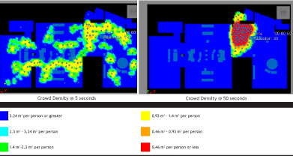
Selected Research activities of the Faculty
Development of master curricula for natural disasters risk management in Western Balkan countries
Drones applications in disaster management
Applied Biometrics
Evacuation of buildings based on real-time data
Óbuda University, Budapest, Hungary (OE)

Slide 12

Thanks for your attention!
Development of master curricula for natural disasters risk management in Western Balkan countries
Óbuda University, Budapest, Hungary (OE)

